Slide 1
VIBE AI HACKTON
PROBLEM STATEMENT :
Navigating a tech career alone is overwhelming, isolating, and inefficient.
THEME: HR TECH SOLUTION
TEAM NAME : CODEBREAKERS

Slide 2
PROBLEM STATEMENT
Aspiring tech professionals struggle with fragmented learning resources and lack personalized guidance, leading to wasted time, lost motivation, and difficulty transitioning from skill acquisition to employment.
“Our solution is an AI-powered career companion that guides, tracks, and connects users to skills, jobs, and growth opportunities.”
WHY THIS IS IMPORTANT?
Bridging the Skill Gap – Turns learners into job-ready professionals. Ending Career Confusion – Personalized AI guidance keeps users on track. Equal Access for All – AI mentorship for everyone, anytime. Boosting Employability – Matches skills with real-world job needs
WHO IS FACING THIS ISSUES ?
Students & Fresh Graduates – Struggle to find clear career direction after studies.
Self-Learners – Overwhelmed by scattered online resources and lack of structure.
Underrepresented Learners – Lack access to mentors or personalized career guidance.

Slide 3
UNIQUES
Pathfinder delivers AI-powered personalization, creating a unique roadmap for every user’s career goal.
Combines learning, progress tracking, and job discovery in one seamless app.
Turns AI into a personal career coach, not just a question-answering bot.
Bridges the gap between skills and opportunities with smart, data-driven guidance
IDEA/SOLUTION
We provides AI-powered career Q&A that instantly converts doubts into clear, skill-based guidance (not just generic).
We builds adaptive personalized roadmaps, updating dynamically as users learn and achieve milestones.
We combines gamified daily streak-based interview & DSA practice, making learning consistent and engaging
We directly connects skills to opportunities by filtering jobs and internships from LinkedIn in real time.
We integrates resume building with achievement tracking, creating a living profile that grows the answers with user.
UNIQUES
Pathfinder delivers AI-powered personalization, creating a unique roadmap for every user’s career goal.
Combines learning, progress tracking, and job discovery in one seamless app.
Turns AI into a personal career coach, not just a question-answering bot.
Bridges the gap between skills and opportunities with smart, data-driven guidance
Path finder
guidance + learning + tracking + opportunities

Slide 4
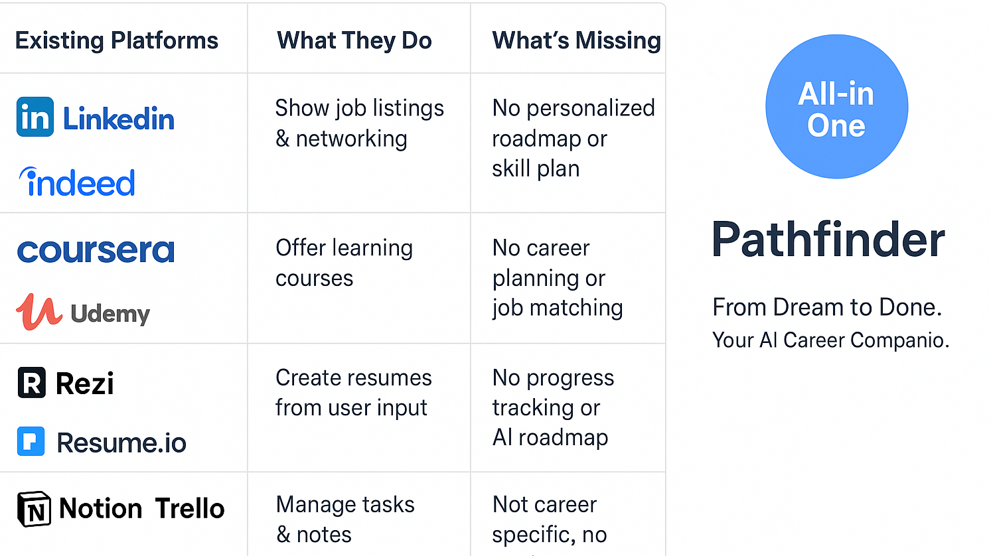
How Pathfinder is different from others

Slide 5
DESIRABILITY
DESIRABILITYDESIRABILITY
👥 Target Users
Students exploring or confused about their career path
Self-learners and career switchers seeking structure
Early professionals looking to upskill and get noticed
Colleges and institutions aiming to guide students effectively
Pain Points Solved
Lack of personalized guidance despite abundant resources
No single space to learn, track, and apply for jobs
Losing motivation due to scattered platforms and no roadmap
Struggling to convert skills into a professional resume
Difficulty identifying real job requirements and matching them

Slide 6
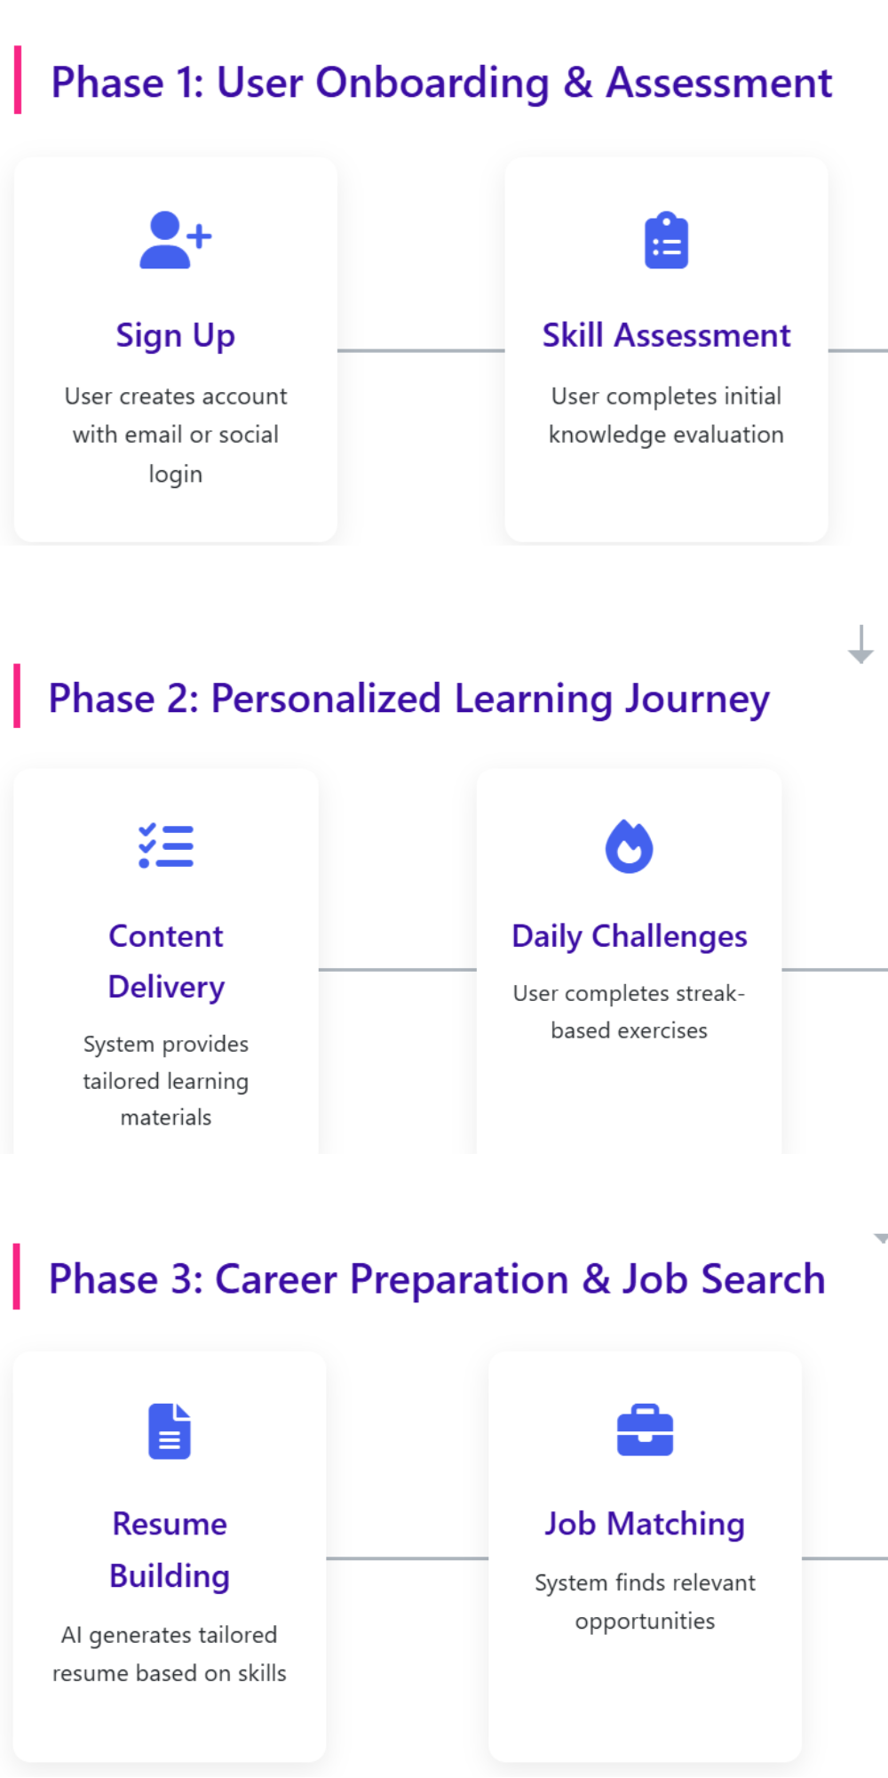
TECHNOLOGY STACKS
Frontend: HTML, CSS, JavaScript
Backend: Node.js with Express.js
Database: MongoDB
AI/ML Layer: OpenAI
Job Integration: LinkedIn API / Web Scraping for internships & jobs
Additional Tools: GitHub / Git for version control
FLOW CONTROL ARCHITECTURE

Slide 7
FREE VERSION VS PREMIUM VERSION
Feature | Free Version | Premium Version
Career Q&A | ✅ Yes | ✅ Yes (Detailed Guidance)
Roadmap | ⚪ Basic General Plan | Personalized Roadmap
Progress Tracking | ⚪ Limited | Dynamic & AI Updated
DSA & Interview Practice | ⚪ General Questions | Domain-Specific Streaks
Job & Internship Suggestions | ❌ | Yes (Based on Profile)
Resume Builder | ❌ | AI Tailored Resume
Motivation System | ⚪ Basic | Gamified Achievements

Slide 8
FESABILITY
FESABILITY:
The app is practical and can be developed with current AI and web technologies.
AI can answer career questions and suggest required skills effectively.
User data can be used to create personalized learning and career roadmaps.
Daily practice questions and job/internship suggestions can be automated.
Resume building and achievement tracking can be integrated without major technical issues.
POTENTIAL CHALLENGES AND RISKS:
As this success in based in the understanding of user by ai .User need care on answering questions
Has a college student creating a database for all domains is difficult

Slide 9
Viability
Freemium model ensures accessibility + revenue flo
Freemium model ensures accessibility + revenue flow
Premium users sustain long-term scalability
AI personalization improves retention rate
Solves global skill gap in the job market
Potential for integration with edtech and HR tools
s sustain long-term scalability
AI personalization improves retention rate
Solves $8.5T global skill gap in the job market
Potential for integration with edtech and HR tools

Slide 10
NOVELTY
Introduces AI-driven personalization that evolves with each user’s growth and goals.
Combines learning, practice, and job placement into one seamless platform.
Acts as an AI career companion, not just a chatbot — guiding users continuously.
Bridges skill-building to real opportunities with LinkedIn job matching and resume creation.
Uses gamified progress tracking to keep users motivated and consistent
ces AI-driven personalization that evolves with each user’s growth and goals.
Combines learning, practice, and job placement into one seamless platform.
Acts as an AI career companion, not just a chatbot — guiding users continuously.
Bridges skill-building to real opportunities with LinkedIn job matching and resume creation.
Uses gamified progress tracking to keep users motivated and consistent

Slide 11
Desirability — Why Users Want It
Solves real frustration with scattered learning resources
Personalization keeps users motivated and consistent
Provides measurable progress with gamification
Bridges the gap between learning and real hiring
Empowers students to design their unique career journey

Slide 12
Demo Prototype
Github link:
https://github.com/Prithiksha-V/vibeaihackton.git

Slide 13
IMPACT WE WANT TO DELIVER
To democratize access to high-quality career opportunities, making success based on skill rather than background.
To empower individuals to take control of their future through personalized learning and direct paths to employment.
To bridge the global skills gap by efficiently connecting passionate talent with the companies that need them.
To fuel innovation by helping people to unlock their potential and contribute the tech-driven economy.

Slide 14
Team & Roles
PRITHIKSHA V | BUILDING FRONTEND AND CONNECTING API’S AND BACKEND
VIJAYALAKSHMI .S | BUILDING BACKEND
AMIRTHA PRIYA .S | BUIDING FRONTEND
ABIRAMI.S | BUILDING BACKEND

Slide 15
ASKS
As we are beginners we need mentorship and feedback to guide us and say some tricks and tips to accomplish this

